Slide 1
Women Seeking International Protection’s Mental Health in the EU
European Initiative for Women’s Health
Webinar
Allyson Zucker
2023 Sep 12

Slide 2
Research Questions
1
Why is there a need to address gender differences in people seeking international protection’s mental health, specifically depression, anxiety, and post-traumatic stress disorder (PTSD)?
What are some examples of mental health interventions and policies that respond properly to women seeking international protection experiencing depression, anxiety, and PTSD?
2
1

Slide 3
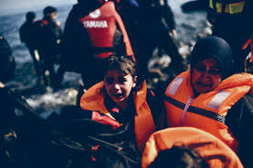
1
Call to action for women seeking international protection
Mass migration due to anthropogenic and natural disasters
Economic stagnation
Current EU Focus on mental health
Additional barriers, such as language, stigma, discrimination, etc.
Distinct expression and treatment of mental illness from men
2
Notes:
https://commission.europa.eu/strategy-and-policy/priorities-2019-2024/promoting-our-european-way-life/statistics-migration-europe_en#:~:text=962%2C200%20applications%2C%20including%20881%2C200%20first,than%20in%202019%2C%20before%20COVID.
https://www.europarl.europa.eu/news/en/press-room/20230109IPR65918/europeans-concerned-by-cost-of-living-crisis-and-expect-additional-eu-measures

Slide 4
2
Policy Recommendations Summary
z
Cross-Sector Coordination
R&D
Access
Awareness
Mental health screening upon arrival
Data disaggregation
Representation in epidemiological studies and clinical trials
Access to trauma-informed, culturally-competent, and language-specific care by:
Reducing barriers for migrant clinical workers to practice
Peer mentor programs
IOM cultural mediators
Gender, cultural competence, and discrimination training
Methodical placement of health centers with range of digital and in-person programs
De-stigmatization campaign against mental health conditions
Terminology that shifts from crisis to opportunity
Multi-disciplinary approach
Women seeking international protection-specific endpoints in existing programs
Integration of social and health care budgets:
Language programs
Sexual & reproductive health
Affordable, accessible childcare
3
Notes:
Co-created with women
Talk about who does what…
Work with EU4Health Programme, WHO mental health strategy, comprehensive approach to MH from the EU
Add that all should be informed by lived experience / voices of the women

Slide 5
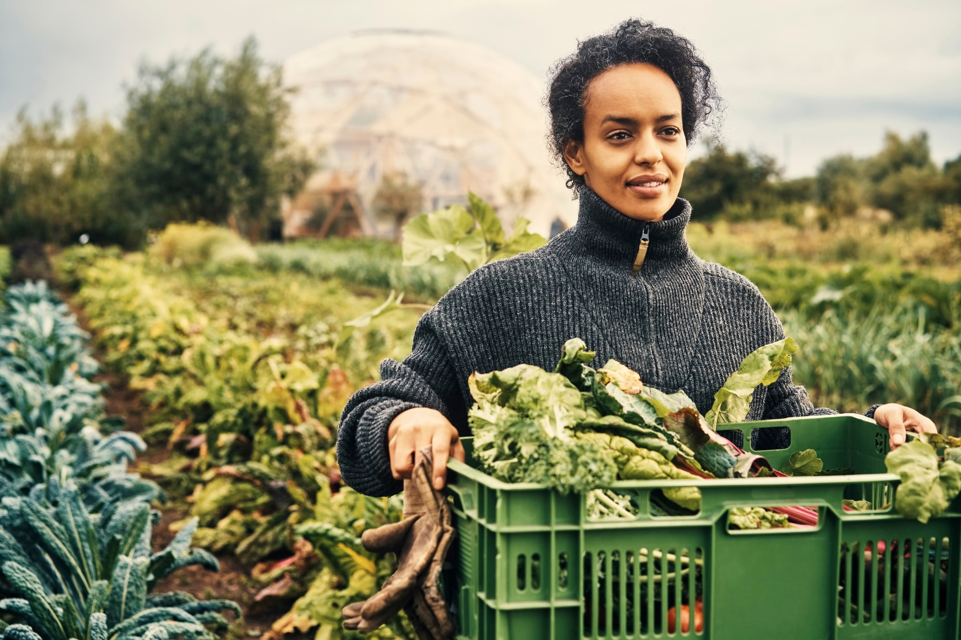
There is hope for “the future about us and of our children. Think about the progress. The children being a doctor, an engineer having a bright life and a bright future. This makes us feel confident”
- Afghan asylum seeker in Greece⁹
Health intervention helped “locking my thoughts in a lock box and knowing that I have the key. I can unlock the box if I want to.”
- Somali asylum seeker⁸
“I want to do something, I want to give back to the people that have accepted me to their community in the first place.”
- Asylum seeker in Ireland¹⁰
4

Slide 6
References
1. European Commission. (May 2023). Statistics on Migration in Europe. https://commission.europa.eu/strategy-and-policy/priorities-2019-2024/promoting-our-european-way-life/statistics-migration-europe_en
2. IMF. (2023). World Economic Outlook Database: Nominal GDP Growth (Annual %). https://www.imf.org/external/datamapper/NGDP_RPCH@WEO/OEMDC/ADVEC/WEOWORLD
3. IMF. (2019) Macroeconomics of Ageing and Policy Implications. https://www.imf.org/external/np/g20/pdf/2019/060519a.pdf.
4. European Parliament. (January 2023). Europeans concerned by cost of living crisis and expect additional EU measures. https://www.europarl.europa.eu/news/en/press-room/20230109IPR65918/europeans-concerned-by-cost-of-living-crisis-and-expect-additional-eu-measures
5. European Commission. (2023). Communication from the Commission to the European Parliament and the Council - An EU Approach to Mental Health and Wellbeing. https://health.ec.europa.eu/system/files/2023-06/com_2023_298_1_act_en.pdf
6. IOM (2016) ‘2030 Agenda for Sustainable Development’, http://unofficeny.iom.int/2030-agenda-sustainable-development
7. IOM (2023). Women & Girls on the move: a snapshot of available evidence. https://www.migrationdataportal.org/sites/g/files/tmzbdl251/files/2023-03/GDI%20Briefs_Gender_Issue_09-03.pdf
8. Robertson, C.L., Halcon, L., Hoffman, S.J. et al. Health Realization Community Coping Intervention for Somali Refugee Women. J Immigrant Minority Health 21, 1077–1084 (2019). https://doi.org/10.1007/s10903-018-0804-8
9. Braun-Lewensohn, O., Abu-Kaf, S., & Al-Said, K. (2019). Women in refugee camps: which coping resources help them to adapt?. International journal of environmental research and public health, 16(20), 3990.
10. AkiDwA (2020a). Let’s talk: Mental health experiences of migrant women, Dublin: AkiDwA.
5

Slide 7
Graveyard
European Initiative for Women’s Health
Webinar
Allyson Zucker
2023 Sep 12

Slide 8
1
Just headings for presentation
As we’ve already discussed, prevalence for different conditions
Expression, treatment, and access points to health care is different
Why Now?
Mass Migration due to Anthropogenic and Natural Disasters
Economic Stagnation
Current EU Focus on Mental Health
Additional Barriers
GDP growth is slower in the EU than other regions of the world.^{2,3}
The rising cost of living is the most pressing worry for 93% of Europeans.⁴
The migrant community can contribute to economic growth when given the resources.
Examples include:
The European Commission has launched a comprehensive approach to mental health.⁵
“Health & wellbeing” and “Gender Equality” are two of the UN’s Sustainable Development Goals.⁶
The IOM launched a 2030 Agenda to ”leave no migrant behind”.⁶
Migrant women face additional barriers⁷ to access care, including:
Language
Cultural stigma
Economic dependence
Labour discrimination
Lower education in country of origin
Health status
Etc.
In 2015, Europe declared a migration crisis and the numbers continue to rise.
962,200 applications were lodged in the EU in 2022, an increase of 52% in comparison to 2021.¹
2
Notes:
https://commission.europa.eu/strategy-and-policy/priorities-2019-2024/promoting-our-european-way-life/statistics-migration-europe_en#:~:text=962%2C200%20applications%2C%20including%20881%2C200%20first,than%20in%202019%2C%20before%20COVID.
https://www.europarl.europa.eu/news/en/press-room/20230109IPR65918/europeans-concerned-by-cost-of-living-crisis-and-expect-additional-eu-measures

Slide 9
2
Policy Recommendations Summary
z
Cross-Sector Coordination
R&D
Access
Awareness
Integrate mental health screening upon arrival
Disaggregate data
Increase representation in epidemiological studies and clinical trials (with informed consent and compensation)
Increase access to trauma-informed, culturally-competent, and language-specific care by:
Establish focus group to understand qualifications of migrants from their region of origin and reduce barriers for foreign clinical workers to practice
Expand peer mentor programs
Call in IOM cultural mediators
Train health care professionals in gender and cultural competence and impact of discrimination
Designate health center near immigration office with range of digital and in-person programs, including programs for adolescents
De-stigmatization campaign for women and men (due to economic dependence)
Terminology that describes immigrants respectfully (e.g., ”seeking international protection” to recognize as formal process)
Establish women seeking international protection-specific endpoints in existing programs (e.g., SDGs)
Strengthen public-private partnerships (e.g., referral pathways between primary care and social services)
Integrate social and health care budgets
Language programs
Sexual and reproductive health (e.g., free contraception)
Affordable, accessible childcare
3

