Slide 1
Embedding Women´s Health in Policy
Sylvia Gaiswinkler
The Austrian National Public Health Institute (GÖG)
European Parliament
EIWH Women’s Health Interest Group Launch
Brussels, 23th October 2023

Slide 2
The Austrian Action Plan for Women´s Health
17 Goals. 40 Measures.
Initiated by the Minister of Women´s Affairs in 2015
commissioned by the Ministries of Health and Women´s Affairs
developed in a multidimensional and systematic process
intersectional and cross-political (HiAP)
by 4 expert working groups (according to lifephases)
by 50 interdisciplinary experts, 50 organizations
Along three lifephases of women

Slide 3
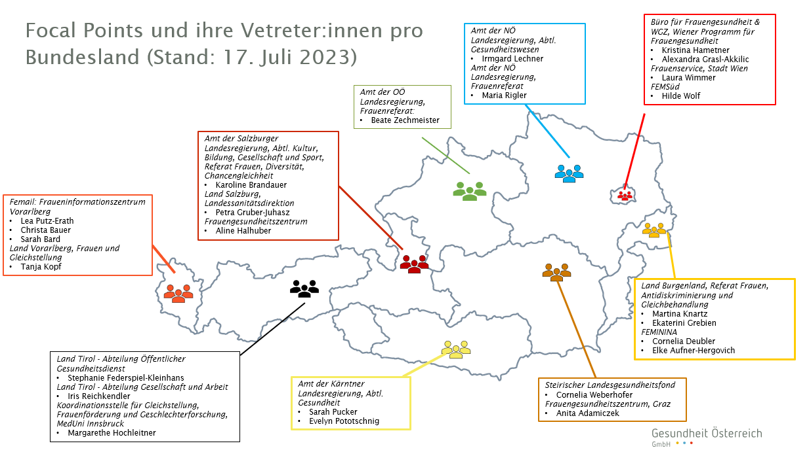
The Implementing Structure
Presentation at the 1st Women´s Health Dialogue by the Austrian Minister of Health in May 2017
Cross-party approval in the Austrian National Assembly in June 2017
Focal Points 1 coordinating link in each federal state, implementation key pillars
Focal Point Meetings Expert exchange with input presentations (2-3 annualy)
Women´s Health Dialogue Intersectoral conference, Austria-wide (1 annualy)
Monitoring via reported 'traffic light system’ from Focal Point Experts
Focal Points for Women´s Health in Austria

Slide 4
Women´s Health Report 2022
A women's health report after more than 10 years
Information on the health situation of girls and women
Topics that are hardly or not at all covered in common health reports
Methodology
Literature research
Secondary data analysis (ATHIS, EU-SILC, HBSC, HLS-EU, diagnosis and service documentation of Austrian hospitals, cause of death statistics)
Supported by an expert group

Slide 5
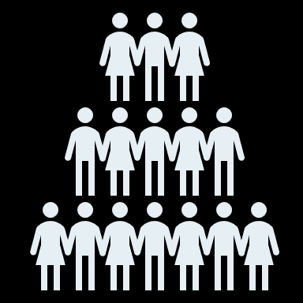
Women´s Health Report 2022 KEY FINDINGS
~ 51 percent of the population are women,
but still:
Challenging data on women-specific or health-related issues for girls and women – including
Menstrual health and menopause, sexual health, reproductive self-determination, girls and women in their different life phases
health impacts due to: multiple stresses, negative body and self-images, experiences of violence
Health issues / diseases that either only affect women, or more frequently or differently than men (e.g. endometriosis)
Striking: existing data often with focus on reproductive health
Recognisable: historically androcentric view in the healthcare system

Slide 6
Women´s Health Report 2022 RECOMMENDATIONS
Shifting perspective for the healthcare system
Raising awareness and consciousness about the issues that affect girls and women – and how they are affected
Knowledge and information generation on girls' and women's health issues
Reflection on data coverage (~ 51 are women)
who is included in the data, which topics are addressed, which topics may not be addressed (blind spots -> e.g. menstrual pain, endometriosis, ...)
Increased research and reporting on women-specific health issues
Including women-specific indicators in health planning, data generation and (health) surveys
Targeted focus on current developments,
especially on digital health and AI systems from a women's and gender health perspective
Integration of women's health experts in decision-making bodies

Slide 7
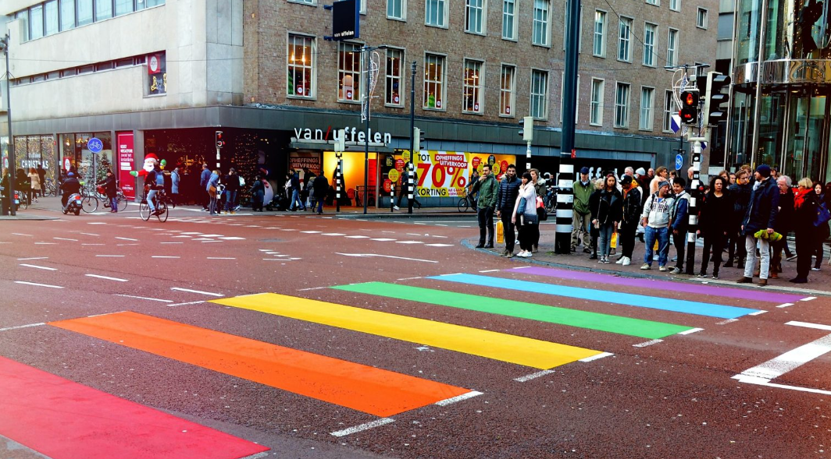
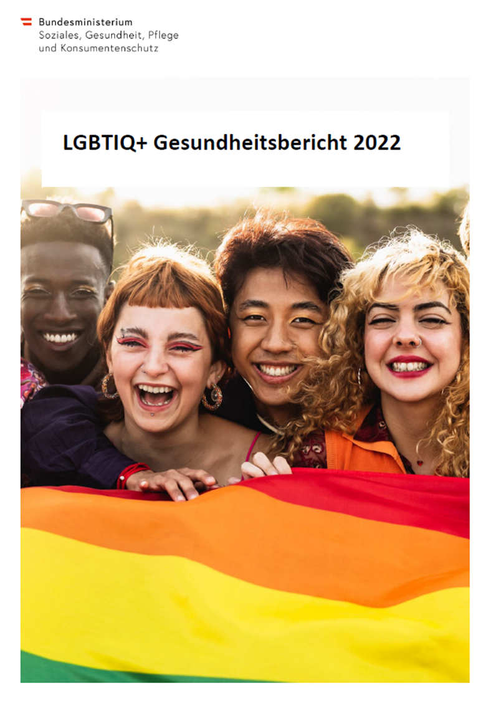
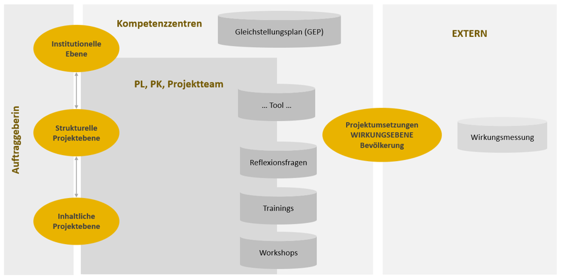
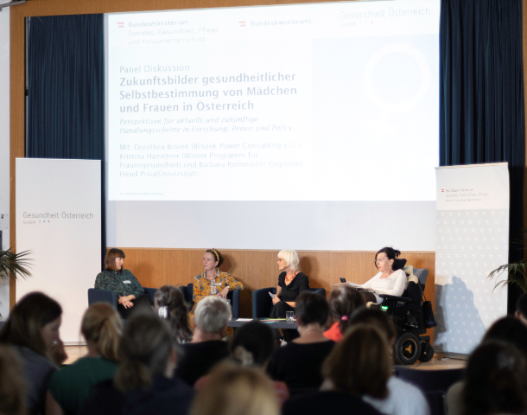
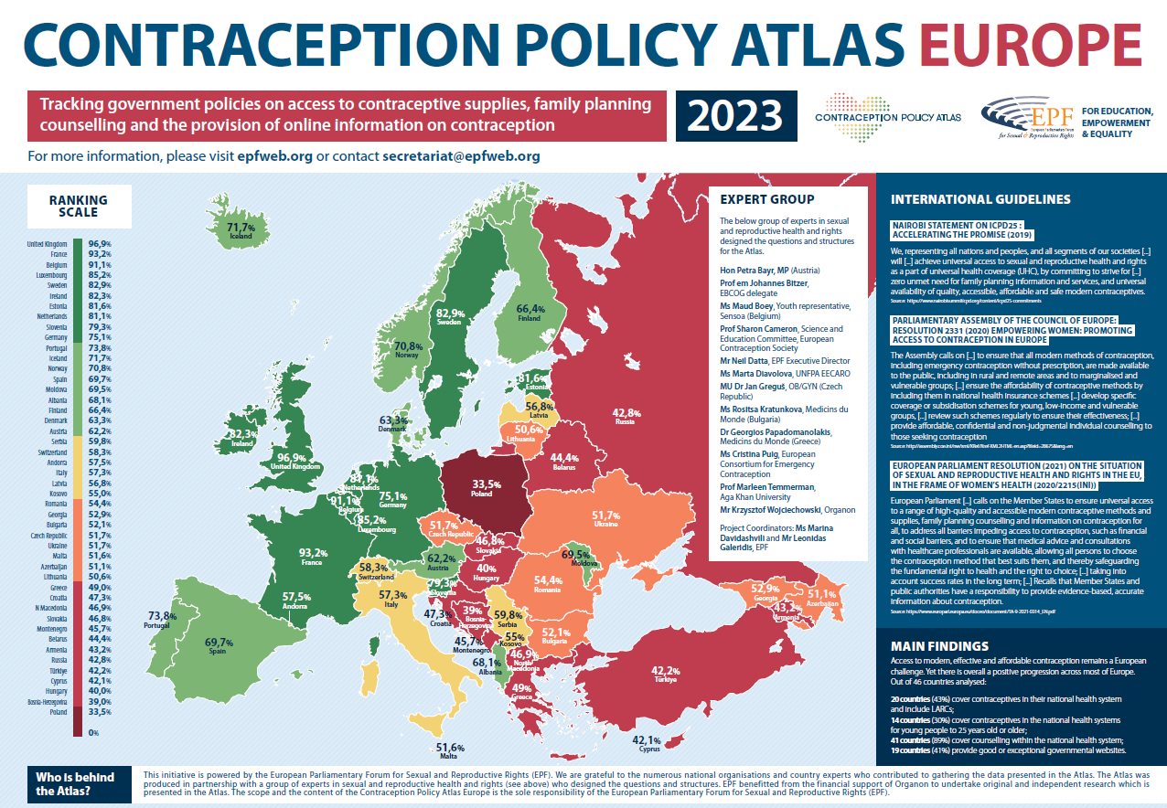
Women´s- and Gender Health Further Work
Survey on mentrual health and menopause (inkl. endometriosis)
LGBTIQ+ measures for raising the awareness of healthcare professionals
LGBTIQ+ Health Report 2022
Study on contraception in Austria
Gender Equity implementation
6. Women´s Health Dialogue
5th June 2023, Vienna
©BMSGPK

Slide 8
Thank you!
Sylvia Gaiswinkler, MA
Senior Health Expert
Coordinating Unit of Women´s and Gender Health
Department: Health, Society and Equity
Gesundheit Österreich GmbH
Stubenring 6 1010 Vienna
T: +43 1 515 61 – 307
sylvia.gaiswinkler@goeg.at
www.goeg.at

